Slide 1
Introduction to SystemVerilog HDVL- Part 2
Copyright © 2021 Intel Corporation.
This document is intended for personal use only.
Unauthorized distribution, modification, public performance,
public display, or copying of this material via any medium is strictly prohibited.

Slide 2
Session Topics
Introduction to SystemVerilog Arrays
Dynamic Arrays, Associative Arrays and Queues
Structures and Unions
Object-Oriented Programming using SystemVerilog

Slide 3
Revisit of SystemVerilog Training Part 1
Synthesizable Constructs
Introduction to the SV data type (2 state and 4 state data types)
Implicit .name and .* associations
Specialized always procedural blocks
Enumerated data types

Slide 4
Key takeaways of the training with hands-on labs (Mostly on the Verification constructs)
Packed and Unpacked arrays
Dynamic Arrays
Associative Arrays
Queues
Structures and Unions
Class and Object
Perform simulation using Questa- Intel FPGA starter edition

Slide 5
SystemVerilog Arrays
ARRAYS
STATIC OR FIXED SIZE ARRAYS
VARIABLE SIZE ARRAYS
PACKED ARRAYS
UNPACKED ARRAYS
DYNAMIC ARRAYS
ASSOCIATIVE ARRAYS
QUEUES

Slide 6
Arrays
In Verilog 2001all data types can be declared as arrays. The reg, wire and all other net types can also have a vector width declared.
A dimension declared before the object name is referred to as “vector width” dimension. The dimensions declared after the object name are referred to as the array dimensions.

Slide 7
Arrays
SystemVerilog substantiates a programmer by providing many data structures for storing a group of objects ,such as Arrays and Queues.
An array is a non-variable size collection of same type of variables.
A queue is a variable size ordered collection of homogeneous objects.
There are one dimensional and multidimensional arrays of variables.
System Verilog classifies an array into :
(i) Packed array
(ii)Unpacked array

Slide 8
Packed and Unpacked arrays
Packed array: The upper and lower bounds of an array are declared in between the variable type and the variable name.
SystemVerilog uses the term Packed array to refer to the dimensions declared before the object name (what Verilog 2001 refers to as the vector width).
The term unpacked array refers to the dimensions declared after the object name.
Packed arrays can only be made of the single bit types (bit, logic, reg , wire and the other net types) and recursively other packed arrays and packed structures.
The maximum size of a packed array can be limited but shall be at least 65536 bits.

Slide 9
Packed and Unpacked arrays
module packed_unpacked_data();
bit [7:0] packed_array = 8'hCC;
reg unpacked_array [7:0] = `{0,0,0,0,0,0,0,1};
initial
begin
$display ("packed array[0] = %b", packed_array[0]);
$display ("unpacked array[0] = %b", unpacked_array[0]);
$display ("packed array = %b", packed_array);
//$display("unpacked array = %b", unpacked_array);
modify %b to %p and observe the outputs
end
endmodule

Slide 10
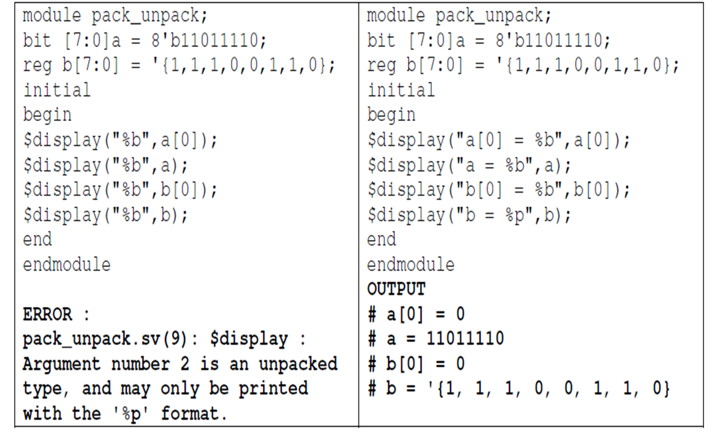
SystemVerilog Packed and Unpacked Arrays

Slide 11
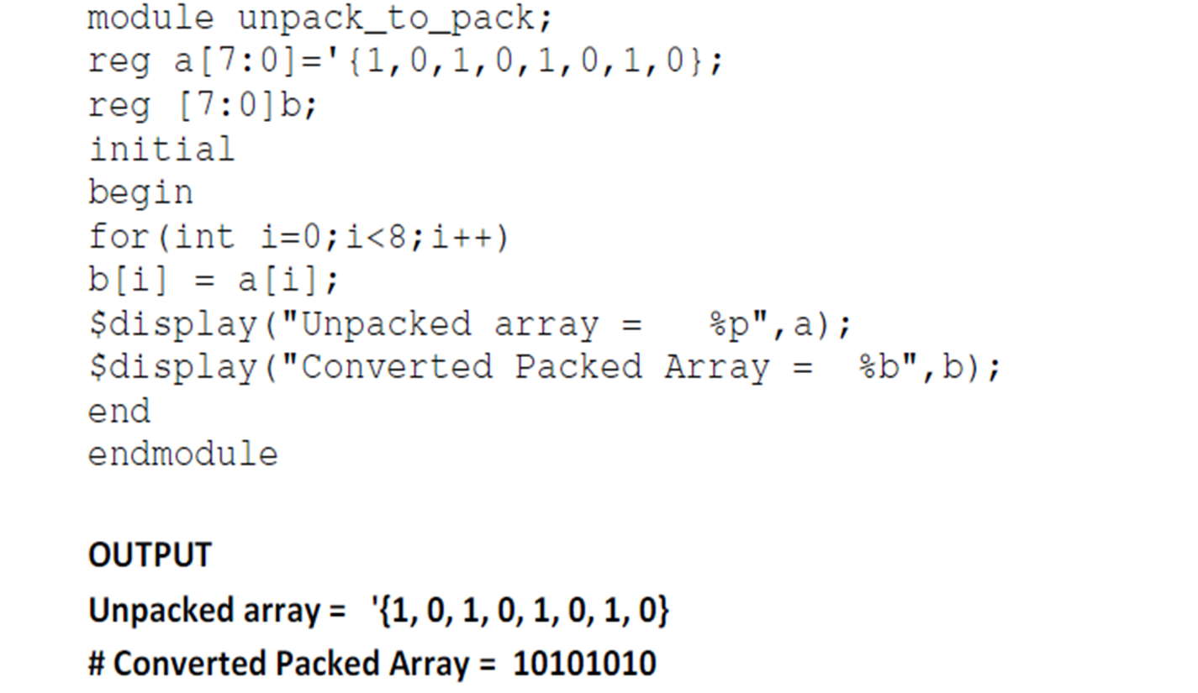
Unpacked Array to Packed Array

Slide 12
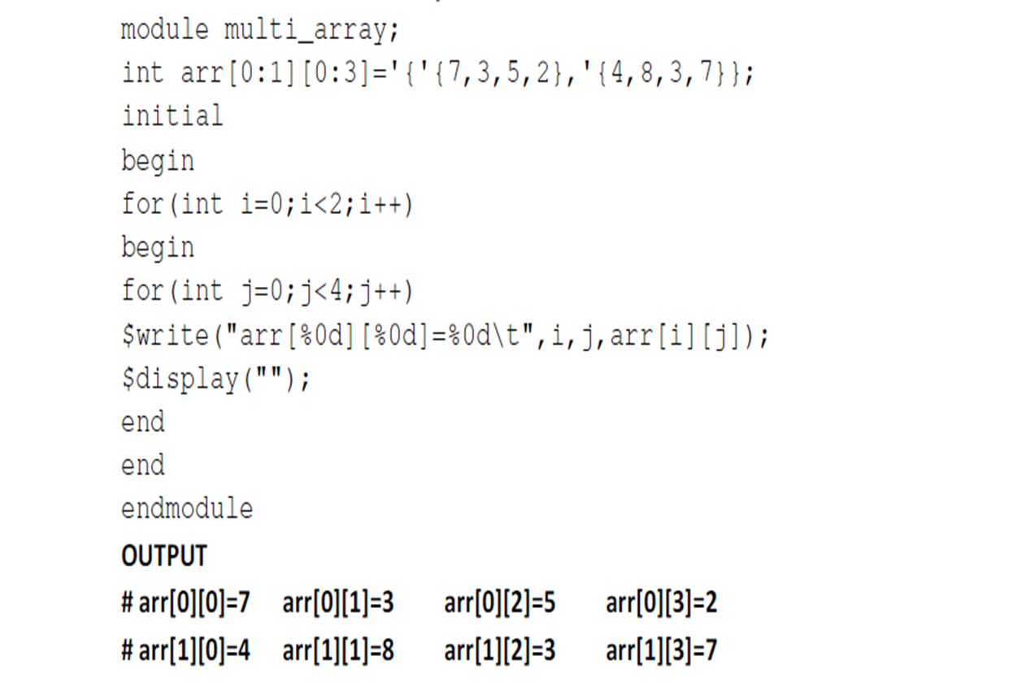
Multi-dimensional Arrays

Slide 13
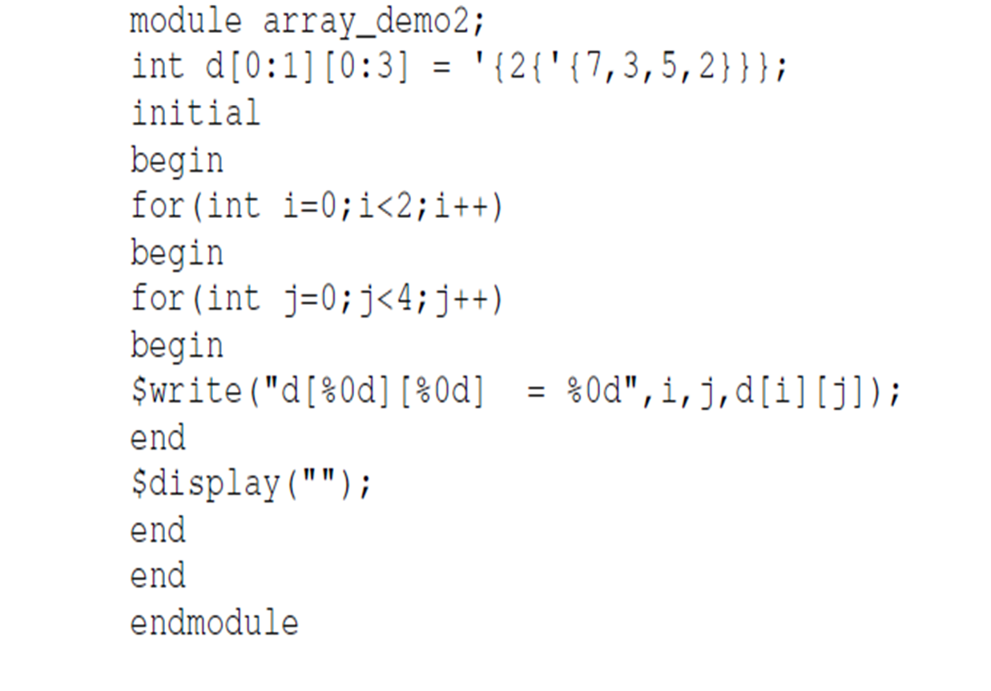
Array Replication

Slide 14
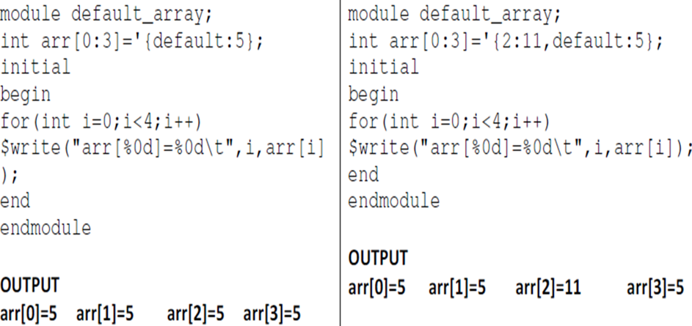
Array with default values

Slide 15
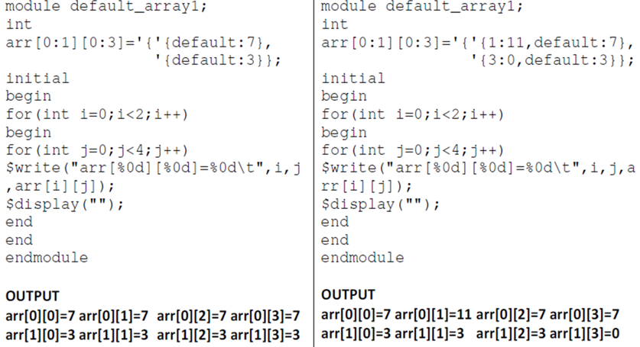

Array with default values

Slide 16
The foreach loop
module foreach_loop ();
byte a [10] = '{0,6,7,4,5,66,77,99,22,11};
initial
begin
foreach (a[i])
begin
$display ("Value of a is %d",i);
end
end
endmodule

Slide 17
Dynamic Arrays
A dynamic array is an unpacked array whose size can be set or changed at run time.
The space for a dynamic array doesn’t exist until the array is explicitly created at run time.
SystemVerilog provides set of function to work with dynamic arrays
new[]:This operator is used to set or change the size of the array.
Size[]: This method returns the current size of the array.
delete[]:This method clears all the elements yielding an empty array (zero size).

Slide 18
Fixed Size and Dynamic Arrays
logic lFA1[2]; // Fixed Size Array
logic lDA1[ ]; // Dynamic Array
initial
begin
$display("lDA1 size = %0d",lDA1.size);
lFA1[1]=1;
lFA1[0]=0;
lDA1=lFA1;
$display("lDA1[1] = %0d", lDA1[1]);
$display("lDA1[0] = %0d", lDA1[0]);
$display("lDA1 size = %0d",lDA1.size);
end

Slide 19
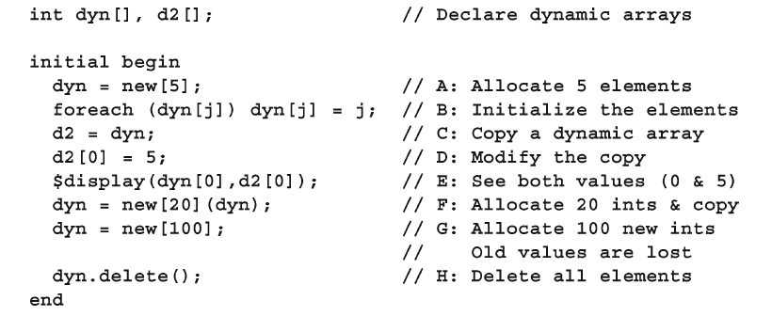
Operations on dynamic arrays

Slide 20
Associative Arrays
Dynamic arrays are useful for dealing with contiguous collections of variables whose number changes dynamically.
When the size of the collection is unknown or the data space is sparse , an associative array is a better option.
Associative arrays do not have any storage allocated until it is used, and the index expressions is not restricted to integral expressions but can be of any type.
An associative array implements a lookup table of its elements of its declared type.

Slide 21
Associative Arrays
module test;
bit [2:0] AA1[*];
int int1;
logic [7:0] log1;
initial begin
int1 = 27;
log1 = 42;
AA1[456] = 3'b101;
AA1[int1] = 3'b000; // index is 27
AA1[log1] = 3'b111; // index is 42
end
endmodule

Slide 22
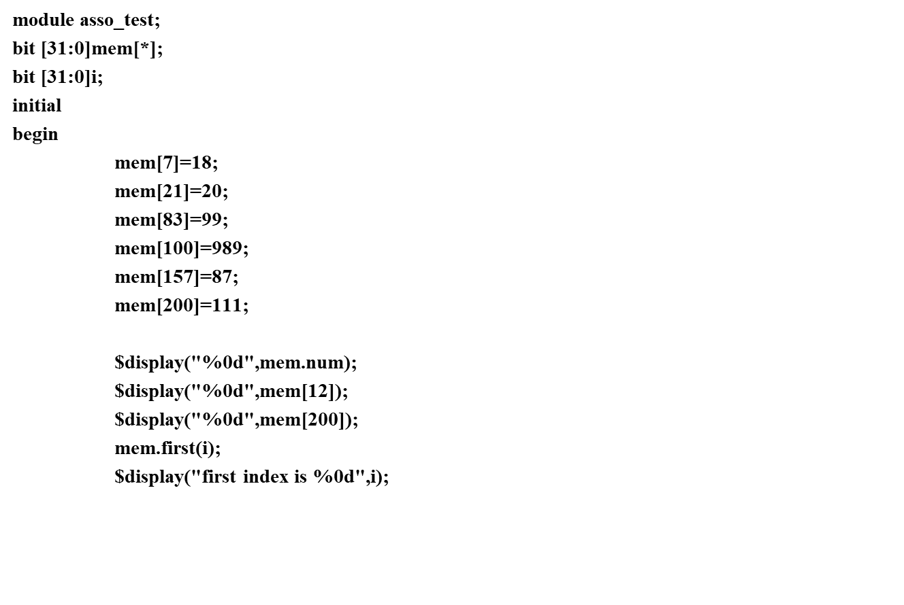
Operations with Associative arrays

Slide 23
Operations with Associative arrays
mem.next(i);
$display("next index of dirst index is %0d",i);
mem.last(i);
$display("Last index is %0d",i);
mem.prev(i);
$display("second last index is %0d",i);
mem.delete(i);
$display("deleted index is %0d",i);
$display("%0d",mem.num);
$display("%p",mem);

Slide 24
Operations with Associative arrays
if(mem.exists(i))
$display("element found at %0d",i);
else
$display("element not found");
$display("%p",mem.max);
$display("%p",mem.min);
mem.delete();
$display("%p",mem);
end
endmodule

Slide 25
Queues
A queue is a variable-size, ordered collection of homogeneous elements
like a dynamic array, queues can grow and shrink
queue supports adding and removing elements anywhere
Queues are declared using the same syntax as unpacked arrays but specifying $ as the array size.
In queue 0 represents the first, and $ representing the last entries.

Slide 26
Queues
A queue can be bounded or unbounded.
bounded queue – queue with the number of entries limited or queue size specified
unbounded queue – queue with unlimited entries or queue size not specified
Queue Declaration
data_type queue_name[$];
data_type – data type of the queue elements. queue_name – name of the queue.

Slide 27
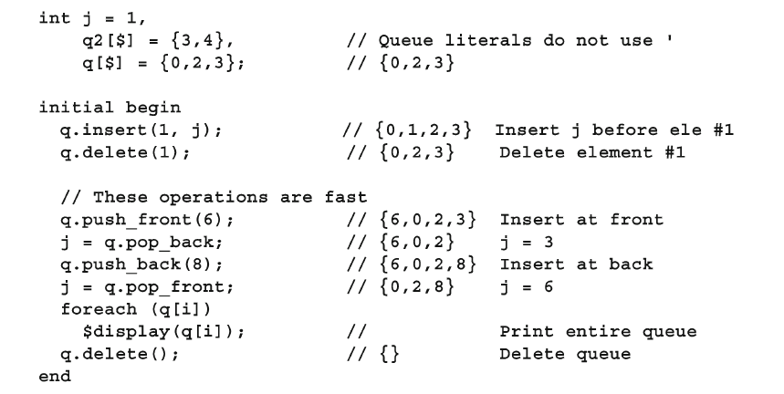
Queue – Built in Functions

Slide 28
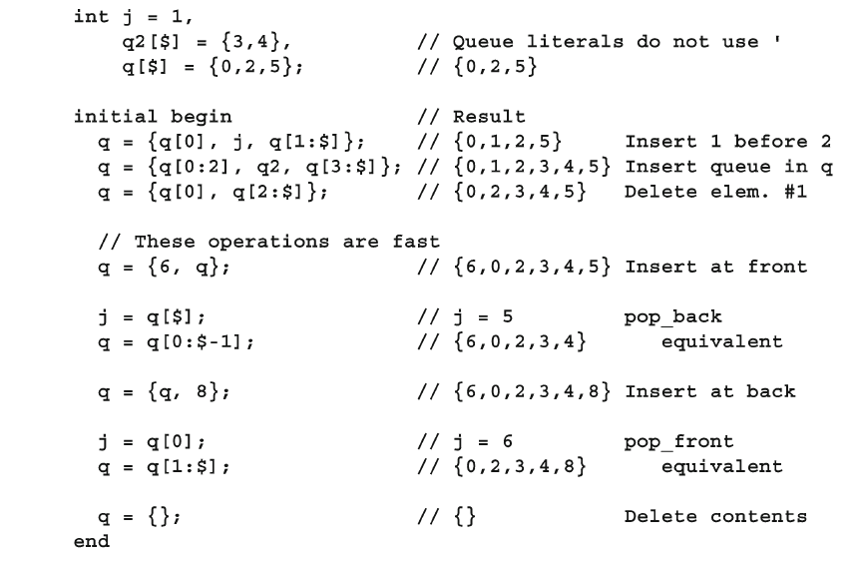
Operations with Queues

Slide 29
SystemVerilog Structures
A structure can contain elements of different data types which can be referenced as a whole or individually by their names.
Syntax:
struct {
[ data members]
} name_of_the_structure;
A structure is unpacked by default. A structure can be packed by explicitly providing the keyword packed.

Slide 30
SystemVerilog Structures
In Packed structures, the MSB of the first element is the MSB of the entire structure and the LSB of the last element will be the LSB of the entire structure.
The data members can be accessed individually or as a group.

Slide 31
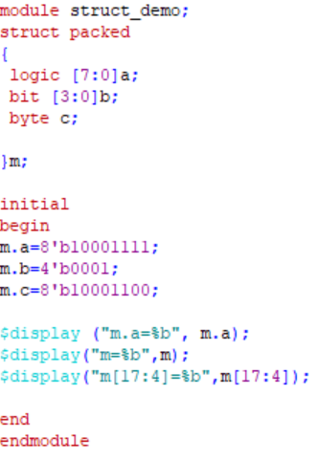
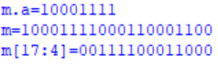
Packed Structures
OUTPUT

Slide 32
SystemVerilog Unions
A SystemVerilog union allows a single piece of storage to be represented different ways using different named member types.
Because there is only a single storage, only one of the data types can be used at a time.
Unions can also be packed and unpacked similarly to structures.
Only packed data types and integer data types can be used in packed union.

Slide 33
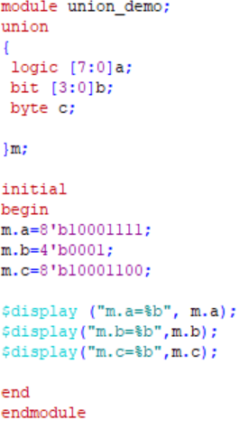
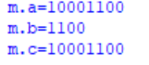
SystemVerilog Unions

Slide 34
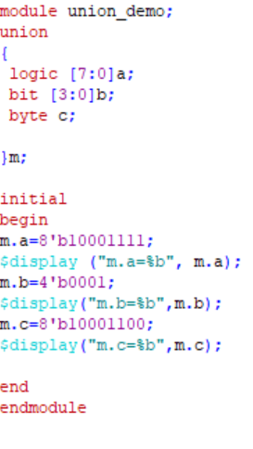
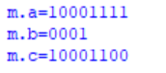
SystemVerilog Unions

Slide 35
Object Oriented Programming using SV
With procedural programming languages such as Verilog and C, there is a strong division between data structures and the code that uses them.
The declarations and types of data are often in a different file than the algorithms that manipulate them.
As a result, it can be difficult to understand the functionality of a program, as the two halves are separate.
Verilog users have it even worse than C users, as there are no structures in Verilog, only bit vectors and arrays.

Slide 36
Need for OOP
If you wanted to store information about a bus transaction, you would need multiple arrays: one for the address, one for the data, one for the command, and more.
Information about transaction N is spread across all the arrays. Your code to create, transmit, and receive transactions is in a module that may or may not be actually connected to the bus.
Worst of all, the arrays are all static, so if your test bench only allocated 100 array entries, and the current test needed 101, you would have to edit the source code to change the size and recompile.
As a result, the arrays are sized to hold the greatest conceivable number of transactions, but during a normal test, most of that memory is wasted.

Slide 37
Benefits of Object-Oriented Programming
Object-Oriented Programming (OOP) lets you create complex data types and tie them together with the routines that work with them.
You can create testbenches and system-level models at a more abstract level by calling routines to perform an action rather than toggling bits.
When you work with transactions instead of signal transitions, you are working at a higher level, and your code is more easily written and understood.
As a bonus, your testbench is decoupled from the design details, making it more robust and easier to maintain and reuse on future projects.

Slide 38
Benefits of Object-Oriented Programming
Helps in creating and maintaining large testbenches:
You can create complex data types and tie them together with the routines that work with them
Increases productivity:
You can create testbenches and system-level models at a more abstract level by calling a routine to perform an action rather than toggling bits
You can work with transactions rather than signal transitions
Allows the Testbench to be reused:
OOP decouples the testbench from design details making it more robust and easier to maintain and reuse

Slide 39
OOPs based Testbench Architecture
Traditional testbenches were oriented around the operations that had to happen: create a transaction, transmit it, receive it, check it, and make a report.
Instead, you should think about the structure of the testbench, and what each part does.
The generator creates transactions and passes them to the next level.
The driver talks with the design that responds with transactions that are received by a monitor.
The scoreboard checks these against the expected data. You should divide your testbench into blocks, and then define how they communicate.

Slide 40
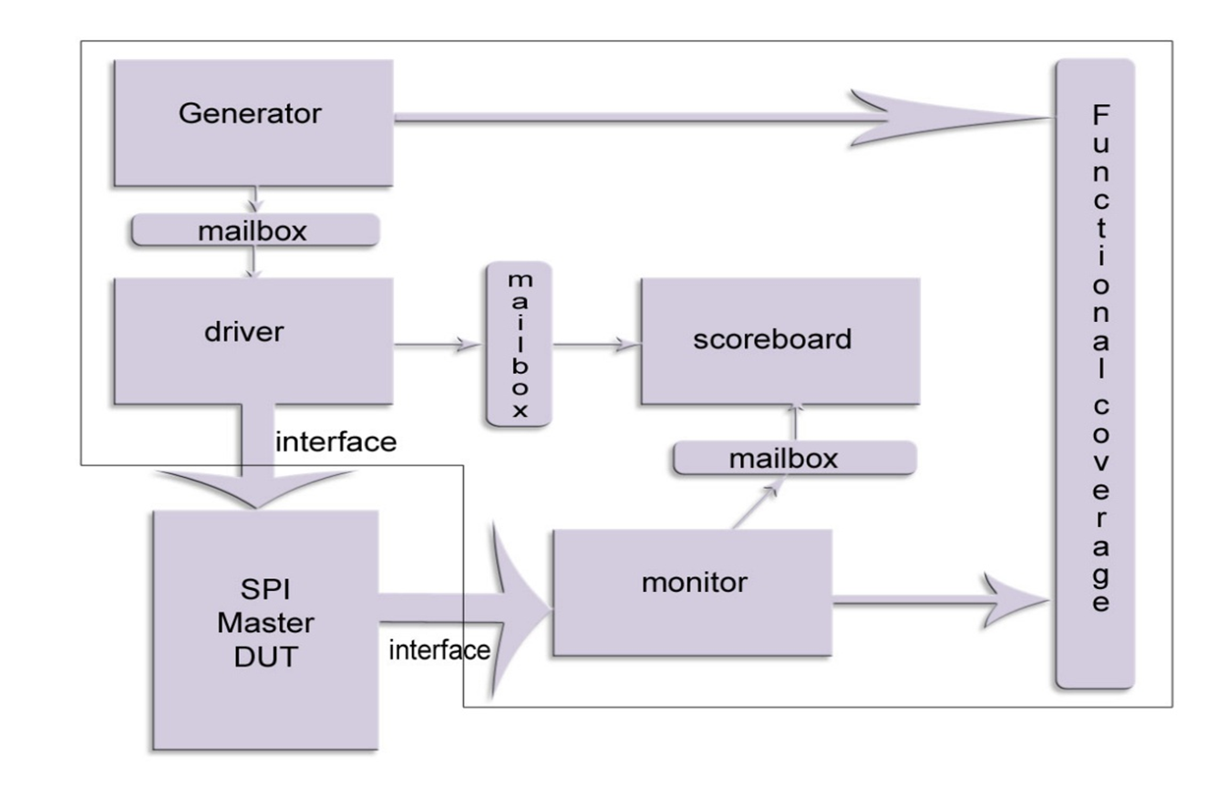
Generic Verification Environment

Slide 41
OOP in System Verilog
How do you represent these blocks in SystemVerilog?
A class may describe a data-centric block such as a bus transaction, network packet, or CPU instruction, Or a class might represent a control block such as a driver or scoreboard.
Either way, a class encapsulates the data together with the routines that manipulate it.
The details of how the class implements actions such as data generation or checking is hidden from the outside, making the class more reusable.

Slide 42
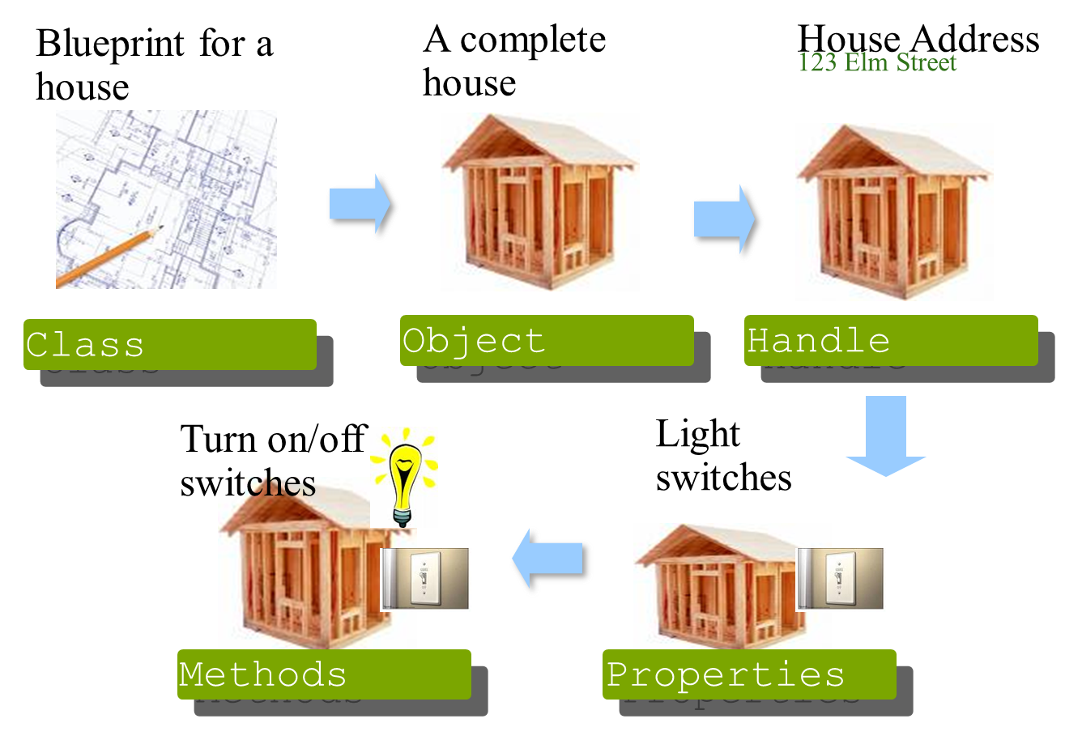
OOP Basics

Slide 43
Classes Vs Structures
Classes are basically dynamic, ultra-flexible structs that can be easily randomized, easily control the randomization, and be created whenever they are needed.
Classes have the multiple field encapsulation capability that exists in structs, plus so much more.
That is why classes are the preferred structure to represent testbench transactions.

Slide 44
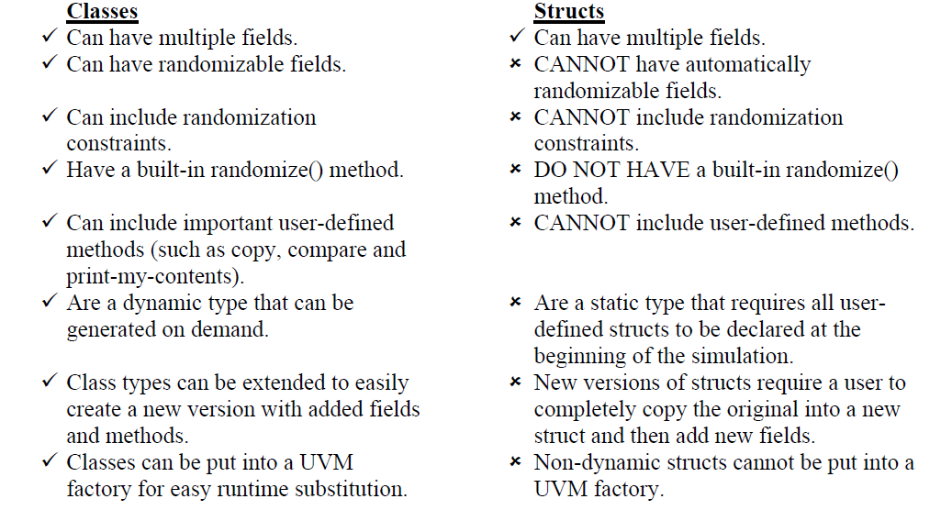
Classes Vs Structures

Slide 45
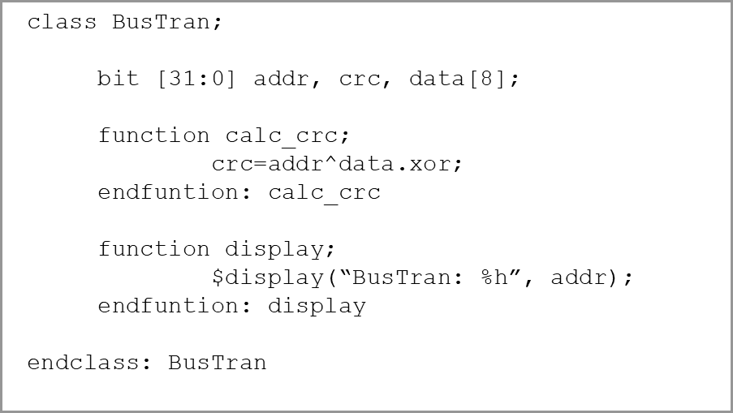
Class Declaration
Your first class
A class encapsulates the data together with the routines that manipulate it
A class’s data is referred to as class properties
Subroutines of a class are called methods

Slide 46
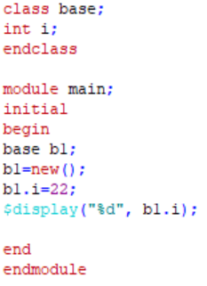

Class Declaration
OUTPUT

Slide 47
References
SystemVerilog for design – Stuart Sutherland
SystemVerilog for Verification – Chris Spear
SystemVerilog 3.1a Language Reference Manual
http://www.sunburst-design.com/papers/

Slide 48
Legal Disclaimers/Acknowledgements
Intel technologies may require enabled hardware, software or service activation
No product or component can be absolutely secure
Your costs and results may vary
Intel, the Intel logo, and other Intel marks are trademarks of Intel Corporation or its subsidiaries. Other names and brands may be claimed as the property of others
OpenCL and the OpenCL logo are trademarks of Apple Inc. used by permission by Khronos
*Other names and brands may be claimed as the property of others

Slide 49
Legal Disclaimers/Acknowledgements
If the presentation includes any performance claims, use this slide instead of slide 10 (and remove this box). Also, follow steps 2-5 on https://legal.intel.com/Marketing/Pages/Notices%20and%20Disclaimers.aspx.
Software and workloads used in performance tests may have been optimized for performance only on Intel microprocessors.
Performance tests, such as SYSmark and MobileMark, are measured using specific computer systems, components, software, operations and functions. Any change to any of those factors may cause the results to vary. You should consult other information and performance tests to assist you in fully evaluating your contemplated purchases, including the performance of that product when combined with other products. For more complete information visit www.intel.com/benchmarks.
Performance results are based on testing as of dates shown in configurations and may not reflect all publicly available ​updates. See backup for configuration details. No product or component can be absolutely secure.
Your costs and results may vary.
Intel technologies may require enabled hardware, software or service activation
No product or component can be absolutely secure
Your costs and results may vary
Intel, the Intel logo, and other Intel marks are trademarks of Intel Corporation or its subsidiaries. Other names and brands may be claimed as the property of others
OpenCL and the OpenCL logo are trademarks of Apple Inc. used by permission by Khronos
*Other names and brands may be claimed as the property of others

Slide 50
Copyright © 2021 Intel Corporation. This document is intended for personal use only. Unauthorized distribution, modification, public performance, public display, or copying of this material via any medium is strictly prohibited.

